Slide 1
JavaScript

Slide 2
Who we are
Komal Jain
Ravi S. Tiwari aka RT
Socially here
Professionally here

Slide 3
What will we cover
History
Language Details
Runtimes and Execution Environment
Types
Variable Declarations
Operators
Conditionals and Loops
Jump Statements
Objects
Array
Function
Utilities

Slide 4
JavaScript - How, When, Why
Marc Andreessen, Netscape founder, believed HTML needed a “glue language”.
Brendan Eich was hired with the goal of embedding Scheme in Netscape Navigator - April 1995.
Instead, Eich was commissioned to create a language that resembled Java.
Eich wrote a prototype in 10 days in May 1995.
Enters Mocha, ahem, LiveScript, ahem, JavaScript.
Standardised by ECMA(European Computer Manufacturers Association): ECMA-262 by committee TC39.
Officially called ECMAScript.
Various implementations of the standard(ECMAScript) viz., JavaScript(most popular), ActionScript, JScript.
Notes:
References: History -
https://www.w3.org/community/webed/wiki/A_Short_History_of_JavaScript
https://en.wikipedia.org/wiki/JavaScript
Find out more about Scheme

Slide 5
JavaScript - The journey so far
Netscape submitted JavaScript to Ecma International - 1996.
First Edition - emergence as ECMA-262 standard - 1997.
Second Edition - ECMAScript 2 - 1998.
ECMAScript 3 - 1999.
ECMAScript 4 - Work started in 2000, never saw the sun - discord among players - guess what - Microsoft.
ECMAScript 3.1 - ECMAScript 4 renamed to 3.1 - 2007.
ECMAScript 5 - ECMAScript 3.1 renamed to 5 - 2009.
Harmony - Agenda to drive language development further.
ECMAScript 5.1 - 2011 - aka ES5 - ECMAScript 5 with minor corrections.
ECMAScript 2015 - 2015 - aka ES6.
ECMAScript 2016 - 2016 - probably ES7.
ECMAScript 2017 - WIP.
Notes:
The language’s development proceeds at a pace much faster than its implementation by vendors - Google for V8, Mozilla for SpiderMonkey, Microsoft for Chakra etc. Hence we have browsers still at ES5. To leverage the new language features, we use Transpilers - Babel, TypeScript etc

Slide 6
JavaScript - Language Details
Started as a scripting language.
Now used as a general purpose programming language. It supports multiple paradigms of programming - Functional, Object Oriented.
From browser to mobiles, servers, embedded systems, TV, you name it.
Atwood Law: “Any application that can be written in JavaScript, will eventually be written in JavaScript”.
Any programming language offers capabilities based on runtime environment.
JavaScript is the same everywhere, but things that can be achieved with it depends on the runtime, e.g. you can access process, stream in Node, but not in browser.
And for the sake of sanity, please read out aloud - “JavaScript is not threaded at all - neither single nor multiple”. Thread, Process fork etc are concerns of runtime not the language.

Slide 7
JavaScript - The runtime aka Engine
JavaScript has come a long way - 20 years.
Big internet giants - Google, Mozilla, Microsoft, Apple - have created respective runtimes aka engines.
Notable among them are - V8 by Google, [Spider, Trace]Monkey by Mozilla, Chakra by Microsoft, Nitro by Apple.
These engines vary in their execution speed and performance - V8 is a winner here, used to power Node, and many more.
Almost all engines compile JavaScript in-place - on browser or on node.
Compilation not in traditional sense - no intermediate bytecode available.
Notes:
Reference: JavaScript compilation - https://github.com/v8/v8/wiki/Design%20Elements#dynamic-machine-code-generation

Slide 8
JavaScript - The Language
ES5.1

Slide 9
JavaScript - Browser as our execution environment
Browsers have built in JS engines.
We will use browser capabilities to run and learn JavaScript.
Create a directory containing two files - index.html and app.js
Refer notes for the content of these files.
Browse the index.html file in chrome
Open Console Tab in Developer Tools
Notes:
Content of Index.html
<!DOCTYPE html>
<html>
<head>
<meta charset="utf-8">
<title>Learning JS</title>
</head>
<body>
<h4>Open Console Tab in Developer Tools</h4>
<script src="/app.js" charset="utf-8"></script>
</body>
</html>
================================
Content of app.js
(function() {
'use strict';
// Do not write anything above this line and do not delete it
// This is our note pad for testing JS
// Write your code here
window.alert('Welcome interns');
console.log('We will use console api for logging purposes');
// Do not write anything below this line and do not delete it
}());

Slide 10
JavaScript - Data Types
JavaScript is loosely-typed, dynamic, case-sensitive language.
var seven = 7;
seven = “See, I am assigned a string value”;
The language defines following data types:
Undefined
Null
Boolean
Number
String
Symbol - ES6 onwards
Object
All but Object are primitive types - they are immutable, their values cannot be changed.
Notes:
Reference:
`var` is used to declare variables
var isJSfun = ture;
isJSfun = "Yes indeed !";

Slide 11
JavaScript - Data types - Undefined
The Undefined type has only one value - undefined - note the lowercase.
Whenever a variable has not been assigned a value, the runtime assigns it the undefined value.
var primitive_undefined;
console.log('Every declared uninitialized variable holds the value : ', primitive_undefined);
console.log('If we try access a variable that is not declared, we get : ');
console.log(undeclared_variable);
Note: The variable must have been declared, otherwise we get a ReferenceError
Notes:
var primitive_undefined;
console.log('Every declared uninitialized variable holds the value : ', primitive_undefined);
console.log('If we try access a variable that is not declared, we get : ');
console.log(undeclared_variable);

Slide 12
JavaScript - Data types - Null
The Null type has only one value - null - note the lowercase.
null represents intentional absence of an object value .
var null_value = null;
console.log(null_value, 'represents intentional absence of Object value');
null_value = new Date();
null is meant for objects, undefined can be used for both primitive values and objects. However, this is not a strict enforcement.
Notes:
var null_value = null;
console.log(null_value, 'represents intentional absense of Object value');
null_value = new Date();

Slide 13
JavaScript - Data types - Boolean
The Boolean data type has two values - true and false.
There is a wrapper object for boolean types - Boolean.
Wrapper objects encapsulate primitive values.
Notes:
var isTrue = true; //... some logic
// somewhere in code
if(isTrue) {
} else {
}

Slide 14
JavaScript - Data types - Number
Number in JavaScript is double-precision 64-bit binary format IEEE 754 value .
Can represent numbers from -(2⁵³ - 1) to 2⁵³ - 1.
In addition, there are three symbolic values -Infinity, +Infinity, NaN(Not a Number)
There are no integers, floats, decimal, long - only numbers. 0(Zero) has two representations -0 and +0. 0 is +0
Number is the wrapper object for Number data type. It has various properties like Number.MAX_VALUE, Number.MIN_VALUE.
Numbers can be represented in decimal, octal, hexadecimal and scientific notations
Decimal = 12345 - any valid decimal digit - 0 through 9
Octal = 01234 - any valid octal digit prefixed with 0 - 0 through 7
Hex = 0xDEADCAFE9 - any valid hex digit - 0 through 9, A through F - case insensitive
Sci = 2.99E8 - either E or e

Slide 15
JavaScript - Data types - String
The String data type represents textual data that are UCS-2 (UTF-16) code points.*
The default encoding for JavaScript is UTF-8.
These are immutable sequence of 16 bits, considered as primitive values.
Operations that seem to modify strings actually return a new string with the modifications.
String is the wrapper object for String type.
There is no character type in JavaScript. Characters are represented as string of length 1.
* UCS-2 represents the Basic Multilingual Plane. It contains all code points from \u0000 to \uFFFF. ES6 supports characters from other planes as well. UCS-2 is deprecated now.
Notes:
Reference :

Slide 16
JavaScript - Data types - Object
Object represents a container type whose value is accessed via reference in memory.
Except primitives, everything in JavaScript is an Object
Date, Array, Math, RegExp, Error, Function, Promise (ES6 onwards) etc all are objects.
Function is an special object with additional capability of being callable.

Slide 17
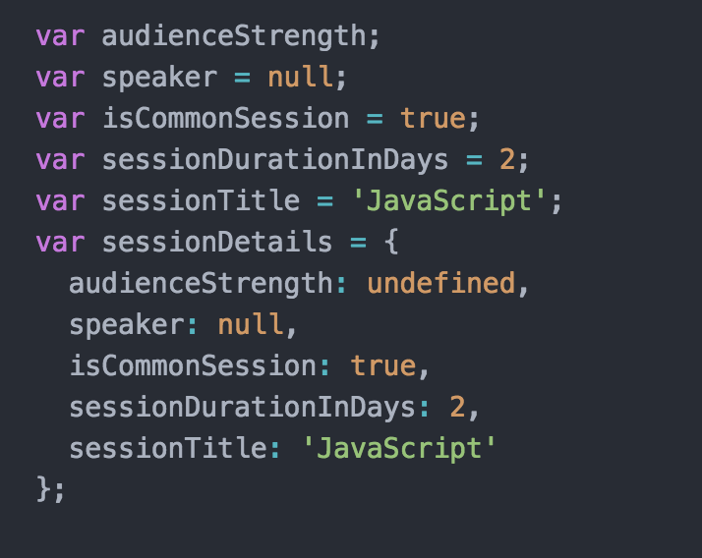
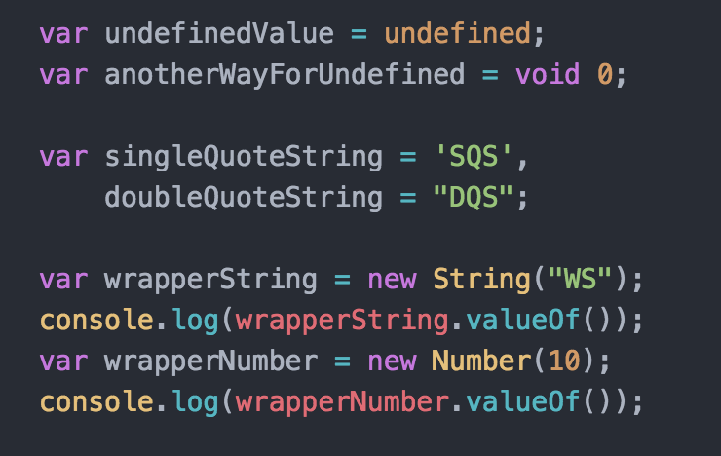
JavaScript - Data Types In Action
Notes:
var audienceStrength;
var speaker = null;
var isCommonSession = true;
var sessionDurationInDays = 2;
var sessionTitle = 'JavaScript';
var sessionDetails = {
audienceStrength: undefined,
speaker: null,
isCommonSession: true,
sessionDurationInDays: 2,
sessionTitle: 'JavaScript'
};
var undefinedValue = undefined;
var anotherWayForUndefined = void 0;
var singleQuoteString = 'SQS',
doubleQuoteString = "DQS";
var wrapperString = new String("WS");
console.log(wrapperString.valueOf());
var wrapperNumber = new Number(10);
console.log(wrapperNumber.valueOf());

Slide 18
JavaScript - Building Blocks In A Glance
Variable | Explanation | Example
String | A string of text. To signify that the variable is a string, you should enclose it in quote marks. | var myVariable = 'Bob';
Number | A number. Numbers don't have quotes around them. | var myVariable = 10;
Boolean | A True/False value. The words true and false are special keywords in JS, and don't need quotes. | var myVariable = true;
Array | A structure that allows you to store multiple values in one single reference. | var myVariable = [1,'Bob','Steve',10]; Refer to each member of the array like this: myVariable[0], myVariable[1], etc.
Object | Basically, anything. Everything in JavaScript is an object, and can be stored in a variable. Keep this in mind as you learn. | var myVariable = document.querySelector('h1'); All of the above examples too.
Notes:
var audienceStrength;
var speaker = null;
var isCommonSession = true;
var sessionDurationInDays = 2;
var sessionTitle = 'JavaScript';
var sessionDetails = {
audienceStrength: undefined,
speaker: null,
isCommonSession: true,
sessionDurationInDays: 2,
sessionTitle: 'JavaScript'
};
var undefinedValue = undefined;
var anotherWayForUndefined = void 0;
var singleQuoteString = 'SQS',
doubleQuoteString = "DQS";
var wrapperString = new String("WS");
console.log(wrapperString.valueOf());
var wrapperNumber = new Number(10);
console.log(wrapperNumber.valueOf());

Slide 19
JavaScript - Comments
Comments can be single line or multi-line.
// This is a single line comment. It spans over a line
/* This can span single or multiple lines*/ // We can mix another comment here
/*
* This is
* a
* multi line comment
*/

Slide 20
JavaScript - Literals
Literals are data values that appear ‘as is’ in a program.
3.14159 // A floating point literal
108 // An integer literal
2.99e8 // A floating point literal represented in scientific notation
“A string literal” // A string literal
‘Another string literal’
true // A boolean literal
false // Another boolean literal
/javascript/gi // A regular expression literal
{key: value} // An object literal
[1,2,3,4,5] // An array literal

Slide 21
JavaScript - Identifiers and Keywords
An identifier is a just a name.
Identifiers must begin with letter(a-z A-Z) or underscore(_) or the dollar sign($). Subsequent characters can be any among these in addition to digits(0-9).
Certain identifiers are reserved by the language. These are called keywords.
Some keywords are:
ES5 ES6 Onwards
var new true class
do null false super
while try const
for catch let
if finally yield
else return

Slide 22
JavaScript - Expressions and Operators
Expression is a phrase that when evaluated produces a value.
Simple expressions are formed by literals or constants. Complex expressions uses operators and operands.
Operators can be numeric, logical, relational or language specific.

Slide 23
JavaScript - Operators
Unary operators : Unary Plus, Minus e.g. +a, -b
Binary operators :
Increment and decrement operators with pre and post variants: ++, --
Arithmetic Operators: Addition + , Subtraction - , Multiplication *, Division /
Logical Operators: And &&, Or ||, Not !
Bitwise Operators: Bitwise And &, Or |, Not ~, Shift Left <<, Shift Right >>
Relational Operators: <, >, <=, >=, ==, !=, ===, !==
Ternary operator : ? : a ? b : c
Language operators :
typeof : Determine type of operand
delete : Remove a property from an object
instanceof : Tests class of an object
in : Test property membership in object
void : Returns undefined value

Slide 24
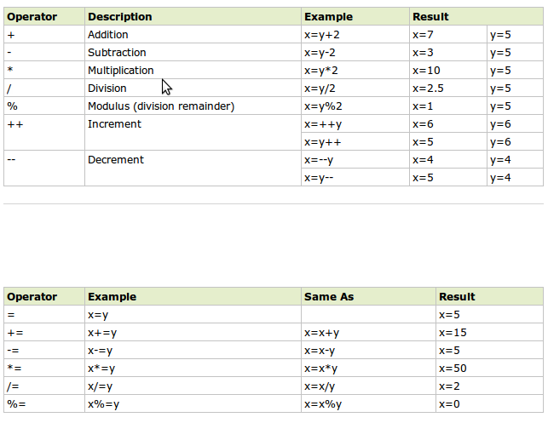
JavaScript - Operators
Unary operators : Unary Plus, Minus e.g. +a, -b
Binary operators :
Increment and decrement operators with pre and post variants: ++, --
Arithmetic Operators: Addition + , Subtraction - , Multiplication *, Division /
Logical Operators: And &&, Or ||, Not !
Bitwise Operators: Bitwise And &, Or |, Not ~, Shift Left <<, Shift Right >>
Relational Operators: <, >, <=, >=, ==, !=, ===, !==
Ternary operator : ? : a ? b : c
Language operators :
typeof : Determine type of operand
delete : Remove a property from an object
instanceof : Tests class of an object
in : Test property membership in object
void : Returns undefined value

Slide 25
JavaScript - Comparators
Unary operators : Unary Plus, Minus e.g. +a, -b
Binary operators :
Increment and decrement operators with pre and post variants: ++, --
Arithmetic Operators: Addition + , Subtraction - , Multiplication *, Division /
Logical Operators: And &&, Or ||, Not !
Bitwise Operators: Bitwise And &, Or |, Not ~, Shift Left <<, Shift Right >>
Relational Operators: <, >, <=, >=, ==, !=, ===, !==
Ternary operator : ? : a ? b : c
Language operators :
typeof : Determine type of operand
delete : Remove a property from an object
instanceof : Tests class of an object
in : Test property membership in object
void : Returns undefined value

Slide 26
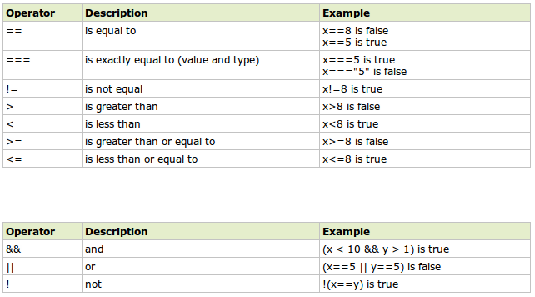
JavaScript - Comparators

Slide 27
JavaScript - Statement
Statements are JavaScript commands that when executed has some side effect on the environment.
Statements are terminated by semicolon.
Statements can be expression statements or declarative statements
Statements can be categorized as
Conditional: if switch
Loop: while for
Jumps: break return throw
Statements can be blocked using curly brackets aka curlies, braces - { }
{
var a = 10;
console.log(‘This is a statement block.’);
}

Slide 28
JavaScript - Declaration Statements
The var and function are declaration statements.
They declare or define variables and functions.
These statements define identifiers (variables and function names) for use in program.

Slide 29
JavaScript - Declaration Statement - var
var declares a variable or many variables.
To declare a variable
var <identifier>;
To declare and initialize a variable
var <id> = <value>;
To assign a variable
<id> = <value>;
We can declare one variable at a time
var greeting = “We are learning JavaScript”;
Or many variables in single statement
var a = 10, statement = ‘Ignorance is sin; cognizance divine’, b = a * 2 ;
We can also use var to declare functions
var square = function(number) { return number * number } ;

Slide 30
JavaScript - Declaration Statement - function
function is used to define functions.
Function declaration has the form
function functionName(arg1, arg2, arg3, […arg4]) {
}
Function declaration statement can be used in expression form to be initialized to a variable. Such an expression is called function expression
var f = function functionName(arg1, arg2, arg3, […arg4]) {
}
A function expression can define a nameless function. Such a definition is called anonymous function.
var f = function (arg1, arg2, arg3, […arg4]) {
}

Slide 31
JavaScript - Conditional Statement
Conditional statements execute or skip statements depending on value of specified statement.
These define decision points known to create branches in code.
The more the branches in code, the more the cyclomatic complexity.
We should strive for less cyclomatic complexity of code.
Notes:
References: Cyclomatic Complexity
https://en.wikipedia.org/wiki/Cyclomatic_complexity

Slide 32
JavaScript - Conditional - if
IF Clause
if (expression)
statement
IF ELSE Clause
if (expression)
statement
else
statement
IF ELSE IF ELSE Clause
if (expression)
statement
else if (expression)
statement
else
statement
Notes:
var iceCream = 'chocolate'; if (iceCream === 'chocolate') { alert('Yay, I love chocolate ice cream!'); } else { alert('Awwww, but chocolate is my favorite...'); }

Slide 33
JavaScript - Conditional - switch
Switch is another conditional statement used when all branches depend on value of same expression.
switch(expression) {
case expression:
statement;
break;
case expression:
statement;
break;
default:
statement;
break;
}
Notes:
var iceCream = 'chocolate';
Switch (IceCream) {
Case 'chocolate' : alert('Yay, I love chocolate ice cream!');
break;
Default : alert('Awwww, but chocolate is my favorite...');
}

Slide 34
JavaScript - Loops - while and do while
While statement is basic looping statement.
There are two variants - while and do while
while (expression)
statement
Do-while
do
statement
while (expression);

Slide 35
JavaScript - Loops - for
for is more convenient looping statement.
for(initialize; test; increment)
statement
For in terms of while
initialize
while(test){
statement;
increment;
}
Notes:
for(var i=0;i==5;i++){
alert("The number is " + i);
}

Slide 36
JavaScript - Jumps - break and continue
Jump statements cause the runtime to jump to new location in source code.
Break statement causes innermost loop or switch statement to exit immediately.
for (i = 0; i< data.length; i++) {
if(data[i] == “key”){
isFound = true;
break;
}
}
Continue restarts the loop at next iteration
for (i = 0; i< data.length; i++) {
if(!data[i]) continue;
total += data[i];
}

Slide 37
JavaScript - Jumps - return
Return causes the runtime to jump to the point from where it was called.
Inside functions, it is used to specify the value of function invocation.
function isEven(candidate) {
var isEven;
if(candidate % 2 == 0)
isEven = true;
else
isEven = false;
return isEven;
}
function total(marks) {
if(!marks)
return; // can return null, or 0 or any value
for(var total = 0, i = 0, j= marks.length, i < j, i++)
total += marks[i];
return total
}

Slide 38
JavaScript - Jumps - throw
Throw is similar to return, except it is used to signal an exception or error in the code.
It also causes the runtime to jump to the point from where it was called.
Exceptions thrown are taken care of by handlers defined using try/catch/finally statements.
function factorial(x) {
// If the input argument is invalid, throw an exception!
if (x < 0) throw new Error("x must not be negative");
// Otherwise, compute a value and return normally
for(var f = 1; x > 1; x--) f *= x;
return f;
}

Slide 39
JavaScript - try catch finally
Try Catch Finally is the exception handling mechanism of JavaScript.
Try is used to define a block of code whose exceptions are to be handled.
Try is followed by catch which contains code to be executed in case of exceptions.
Catch is followed by finally which contains clean up code - executed irrespective of what happens in try.
try {
}
catch (e) {
}
finally {
}
Notes:
Handle Divide by zero error.

Slide 40
JavaScript - Objects
Objects are fundamental data type of the language.
It is unordered collection of properties - a name value pair.
Objects are composite type container - can contain primitives as well as other objects.
Objects provide access for storage and retrieval via named string identifiers.
Objects are dynamic in nature - properties can be added or deleted at run time.

Slide 41
JavaScript - Creating Objects
Easiest way is to create via object literals.
var empty = {};
var point = {x: 10, y: -4};
var sessionDetails = {
“topic”: “JavaScript Language”,
instructors: [‘Komal Jain’, ‘RT’]
}
Objects can be constructed via constructors with new
var o = new Object();
var a = new Array(4);
var d = new Date();
Yet another way is via Object.create
var o = Object.create(null);

Slide 42
JavaScript - Objects - Querying Properties
To query a property, use the dot(.) or square brackets([]) operator.
var intern = { name : 'Abc', college: 'Xyz'};
var internName = intern.name;
var internCollege = intern['college']
We can create or set property values in same way as variable assignment
intern.knownLanguages = ['English', 'Hindi', 'Punjabi'];
intern['has-knowledge-of-programming-languages'] = ['C', 'Java'];
We can query all the properties of an object using the for-in loop
for(var key in object) {
console.log("Key = "+ key +", Value = "+ object[key]);
}
If a missing property is accessed, we get undefined
...contd

Slide 43
JavaScript - Objects - Querying Properties
We can delete properties of an object using the delete operator.
delete intern['has-knowledge-of-programming-languages'];
We can test for the presence of properties using the in operator
"name" in intern
intern.hasOwnProperty('college')
function copyProperties(target, source) {
for(prop in source) {
target[prop] = source[prop];
}
return target;
}
Common object methods are toString, hasOwnProperty, valueOf etc.

Slide 44
JavaScript - Arrays
An array is an ordered collection of values which are index accessible.
Arrays are untyped in JavaScript just as objects.
These are dynamic as well in the sense they can grow and shrink at runtime.
Creating Arrays
Literal form
var empty = [];
var primes = [2,3,5,7,11,13]
var misc = ['string', 123, true, {}, [], null]
Using Array constructor
var a = new Array(); // creates empty Array
var b = new Array(5); // array with length of 5
var c = new Array(3,4,5) // Array with 3 elements - 3,4,5

Slide 45
JavaScript - Arrays - Common Operations
Querying elements
Array members are accessed via the square brackets notation with corresponding index.
misc[2] = false;
var evenPrime = primes[0];
Array length
The length of an array is the number of elements it can accommodate at any given time.
misc.length // 6
Adding elements
Elements can be added using index position
var a = [];
a[0] = ‘zero’ ;
a[1] = ‘one’ ;
Elements can be stuffed in last using the push method
a.push(‘three’);
a.push(‘four’);

Slide 46
JavaScript - Common Array Methods
join: Joins array elements using provided separator and returns string.
reverse: Reverse the order of elements in the array.
sort: Sorts array elements in place using default sorting for elements.
concat: Creates and return new array that contains concatenation of arrays on which it is invoked
slice: Returns a slice(subarray) of the array.
splice: General purpose method for insertion and removal.
push: Appends one or more elements at the end of the array.
pop: Deletes the last element of the array, and returns the element.
shift: Removes and return first element of array
unshift: Adds one or more elements to the beginning of the array.
indexOf: Returns the index of specified element in the array, otherwise returns -1.
Notes:
References: Refer MDN for details
https://developer.mozilla.org/en-US/docs/Web/JavaScript

Slide 47
JavaScript - Advanced Array Method
Following are some advanced array methods that take into consideration a callback. We will learn about callbacks in coming sessions and thus will revisit them in detail.
forEach: Provides general iteration over arrays
map: Used for transformation purposes, maps each element of array to a function for desired output
filter: Used to filter array based on a predicate
reduce: Combine array elements to reduce to a single value.
every: Checks if every array element satisfies the given predicate.
some: Checks if some(one or more) elements satisfy the given predicate.

Slide 48
JavaScript - Functions
function sayHello() {
console.log('Hello Interns');
}
function distance(x1, y1, x2, y2) {
var dx = x2 - x1;
var dy = y2 - y1;
return Math.sqrt(dx*dx + dy*dy);
}
function factorial(n) {
if(n <= 1) return 1;
return n * factorial(n - 1);
}
var sum = function add(a, b) {
return a + b;
}
var product = function(a, b) {
return a * b;
}
prints “Hello interns” to the console
invoke as - sayHello();
a normal function statement
invoke as - distance(0, 0, 5, 5);
a recursive function statement
invoke as - factorial(4)
a named function expression
invoke as - sum(3,5) or add(6, 7)*;
an anonymous function expression
invoke as - product(4,6);
Notes:
*Note : ‘add’ can only be used inside function body
var sum = function add(a, b) {
// ‘add’ can be used inside function body only
return a + b;
}
add(6, 7) raises error. Outside the function body, we can only call it with the name ‘sum’
/////////////////
function sayHello() {
console.log('Hello Interns');
}
function distance(x1, y1, x2, y2) {
var dx = x2 - x1;
var dy = y2 - y1;
return Math.sqrt(dx*dx + dy*dy);
}
function factorial(n) {
if(n <= 1) return 1;
return n * factorial(n - 1);
}
var sum = function add(a, b) {
return a + b;
}
var product = function(a, b) {
return a * b;
}

Slide 49
JavaScript - Utilities - Math
Math is a global utility provided by the runtime for mathematical operations.
Common operations are:
Math.sqrt - For finding square root
Math.pow - For raising a number to a power
Math.round - For rounding a number
Math.floor - For finding floor value of a decimal number
etc

Slide 50
JavaScript - Utilities - Date
JavaScript dates are time values that are number of milliseconds since January 1, 1970 UTC.
There is no literal form for dates. To create date values, always use the Date constructor.
new Date();
new Date(value);
new Date(dateString);
new Date(year, month[, date[, hours[, minutes[, seconds[, milliseconds]]]]]);

Slide 51
JavaScript - Utilities - JSON
JSON stands for JavaScript Object Notation.
It is a format for data interchange via serialization and deserialization.
Its representation is similar to Object literal notation with some variations
Runtime provides parsing and serializing facilities for JSON data through JSON.parse and JSON.serialize functions from string to object and vice-versa respectively.
Sample JSON
{
"id": 1,
"name": "A green door",
"price": 12.50,
"tags": ["home", "green"]
}
Notes:
References: JSON
http://www.json.org/

Slide 52
JavaScript - Utilities - Dialog-Boxes
Three types of dialog boxes:
Alert Box
alert('Welcome to TTN ...');
Prompt Box
var myName = prompt('Please enter your name.');
Confirm Box
Confirm('Are you sure you wanna proceed ?');

Slide 53
Thanks
Queries
Doubts
Discussion

Slide 54
Questions
Prompt for amount, interest rate and no. of years and calculate simple interest.
is palindrome string
Area of circle
Copy information of one object to another and log it to console.
create a list of objects of Employee with info as follow :
Name, age, salary ,DOB
filter all employees with salary greater than 5000
group employee on the basis of their age
fetch employees with salary less than 1000 and age greater than 20. Then give them an increment 5 times their salary.

